Slide 1
Face Tracking and Head Movement Detection
MDC PROJECT PRESENTATION
UP
LEFT
RIGHT
Multi-face real-time tracker with Kalman filtering and cumulative analytics
Chatanya Gupta · Roll No. 2024A1R189
Ankush Dev Singh · Roll No. 224A1R030
B.Tech Computer Science and Engineering
Model Institute of Engineering and Technology (Autonomous), Kot Bhalwal, Jammu, India
DOWN
Notes:
Good morning. This is our MDC project on face tracking and head movement detection. It follows a webcam stream, tracks every face, and measures which direction each person is looking.

Slide 2
Table of Contents
AGENDA
03
Introduction
10
Tools and Technologies Used
04
Problem Statement
11
Implementation
05
Objectives
12
Results and Discussion
06
Existing System
13
Limitations and Future Scope
07
Proposed System
14
Conclusion
08
Methodology
15
References
09
System Design / Architecture
16
Thank You
Notes:
This is the order of the presentation: background first, then the design and implementation, and finally the results, limitations and conclusion.

Slide 3
Introduction
OVERVIEW
Face tracking and head movement detection use a webcam to find people, follow them frame by frame, and work out which way they are facing. This project implements two versions of a real-time system and turns the results into attention statistics.
VERSION 1
OpenCV Haar Cascades
Lightweight, CPU-only detector for face, eyes and smile. Tracks the largest face and reports Left, Right, Up, Down or Center.
Run with main2.py
VERSION 2
MediaPipe + Kalman Filter
Tracks multiple faces with persistent IDs, predicts motion with Kalman filters and builds a cumulative attention report.
Run with main.py
Notes:
Face tracking finds faces in a video and follows them. Head movement detection goes one step further and tells us where the person is looking. We built two versions: a lightweight one with OpenCV and a more capable one with MediaPipe.

Slide 4
Problem Statement
WHY THIS PROJECT
THE PROBLEM
Build a real-time system that detects every face in a webcam stream, keeps a stable identity for each person, finds which direction they are looking, and summarises attention over the whole session.
ID swapping
When faces cross or move fast, simple trackers mix up who is who.
1
Occlusion
Faces turn away or are hidden for a moment and the track is lost.
2
Re-entry
A person who leaves and returns is counted as someone new.
3
Noise
Very short false detections spoil the final statistics.
4
Notes:
Detecting a face in one frame is easy. The hard part is keeping the same identity for each person over time, and turning that into something useful such as an attention measure.

Slide 5
Objectives
WHAT WE SET OUT TO DO
Objective | How the system achieves it
Detect multiple faces in real time | MediaPipe face detection on every webcam frame
Keep each person's identity stable | Hybrid matching using position and visual similarity
Recognise people who return | HSV colour-histogram fingerprint (re-identification)
Stay stable during brief occlusion | 2D Kalman filter predicts position, 45-frame buffer
Classify attention direction | Nose position inside the face box: Center, Left, Right, Up, Down
Report session attention | Cumulative PNG report with overall and per-face charts
Notes:
Each objective on the left has a matching technique on the right. We will see each of these in the methodology and implementation slides.

Slide 6
Existing System
BASELINE: VERSION 1
HOW IT WORKS
Haar cascades (Viola-Jones) detect the face, eyes and smile.
Only the largest face in the frame is used.
Direction comes from where the face box sits relative to the frame centre.
Confidence grows with distance from the centre.
Runs on any CPU. ESC exits.
WHERE IT FALLS SHORT
Tracks a single face, with no persistent ID.
Direction depends on where you sit in the frame, not on how the head turns.
No prediction or smoothing, so a missed frame loses the face.
No session analytics or report.
Haar detectors are sensitive to pose and lighting.
Notes:
The existing, baseline approach is the Haar cascade tracker, which is Version 1 of our own code. It is fast and simple, but it is limited to a single face and has no memory of who it saw.

Slide 7
Proposed System
VERSION 2: MEDIAPIPE
1
2
3
Persistent Re-ID
HSV histogram fingerprints let a returning person keep the original Face ID.
Hybrid association
Position plus visual similarity prevents ID swapping.
Direction analysis
Center, Left, Right, Up or Down from the nose keypoint.
4
5
6
Kalman smoothing
Predicts each face's position and rides out short occlusions.
Cumulative dashboard
Overall and per-face attention charts saved as a PNG.
Noise filtering
Faces seen for under 2 seconds are left out of the report.
Notes:
Version 2 keeps the same goal but adds six things: persistent re-identification, hybrid matching, direction analysis, Kalman prediction, a cumulative dashboard and noise filtering.

Slide 8
Methodology
PROCESSING PIPELINE, PER FRAME
1 Capture
2 Detect
3 Predict
4 Associate
5 Re-ID
6 Analyse
Read a webcam frame and mirror it.
MediaPipe returns faces, nose keypoint and confidence (min 0.5).
Kalman filter predicts where each tracked face should be.
Match detections to tracks: 0.7 distance + 0.3 visual score.
Unmatched faces are compared with stored histograms; reuse old ID or make a new one.
Update direction and time per direction. Press q to build the report.
A track is dropped after 45 missed frames, and its histogram and times are kept for re-identification.
Notes:
For every webcam frame the system runs the same six steps. The loop ends when the user presses q, and then the report is generated.

Slide 9
System Design / Architecture
MODULES AND DATA FLOW (VERSION 2)
Webcam
cv2.VideoCapture(0)
main.py
loop, overlay, FPS
face_tracker.py
MultiFaceTracker, FaceState
kalman_filter.py
KalmanFilter2D
Live window
boxes, IDs, direction
analytics.py
generate_session_report()
session_report.png
aggregate + per-face
Version 1 is a single, independent script (main2.py) that uses only OpenCV Haar cascades, so it needs none of these modules.
Notes:
main.py is the entry point. It reads the camera, calls the tracker for every frame and draws the live window. face_tracker.py uses kalman_filter.py. When q is pressed, analytics.py turns the session data into the PNG report.

Slide 10
Tools and Technologies Used
SOFTWARE STACK
Technology | Used for | Version
Python | Programming language for the whole project | 1 and 2
OpenCV | Webcam capture, drawing, HSV histograms, Kalman filter | 1 and 2
Haar cascades | Face, eye and smile detection (Viola-Jones) | 1
MediaPipe 0.10.14 | Fast face detection with nose keypoint | 2
NumPy | Matrices for the Kalman filter | 2
Matplotlib | Pie charts and the cumulative session report | 2
Notes:
Everything is Python. OpenCV does image work and the Kalman filter, MediaPipe does face detection, NumPy holds the matrices and Matplotlib draws the report.

Slide 11
Implementation
KEY ALGORITHMS AND PARAMETERS
Direction rule (face_tracker.py)
Kalman filter
State [x, y, dx, dy], dt 0.033, noise Q 0.05, R 0.1
ox = (nx - cx) / (bw / 2)
oy = (ny - cy) / (bh / 2)
if abs(ox) < 0.08 and abs(oy) < 0.08:
return "Center"
if abs(ox) > abs(oy):
return "Right" if ox > 0 else "Left"
return "Down" if oy > 0 else "Up"
Association score
0.7 x distance + 0.3 x visual similarity
Re-identification
16x16 HSV histogram, correlation above 0.45
Lost track
Dropped after 45 missed frames
Report filter
Faces seen under 2 s are ignored
Notes:
On the left is the real direction rule from face_tracker.py. The nose offset is divided by half the box size, so the rule works for any face size. On the right are the main parameters we tuned.

Slide 12
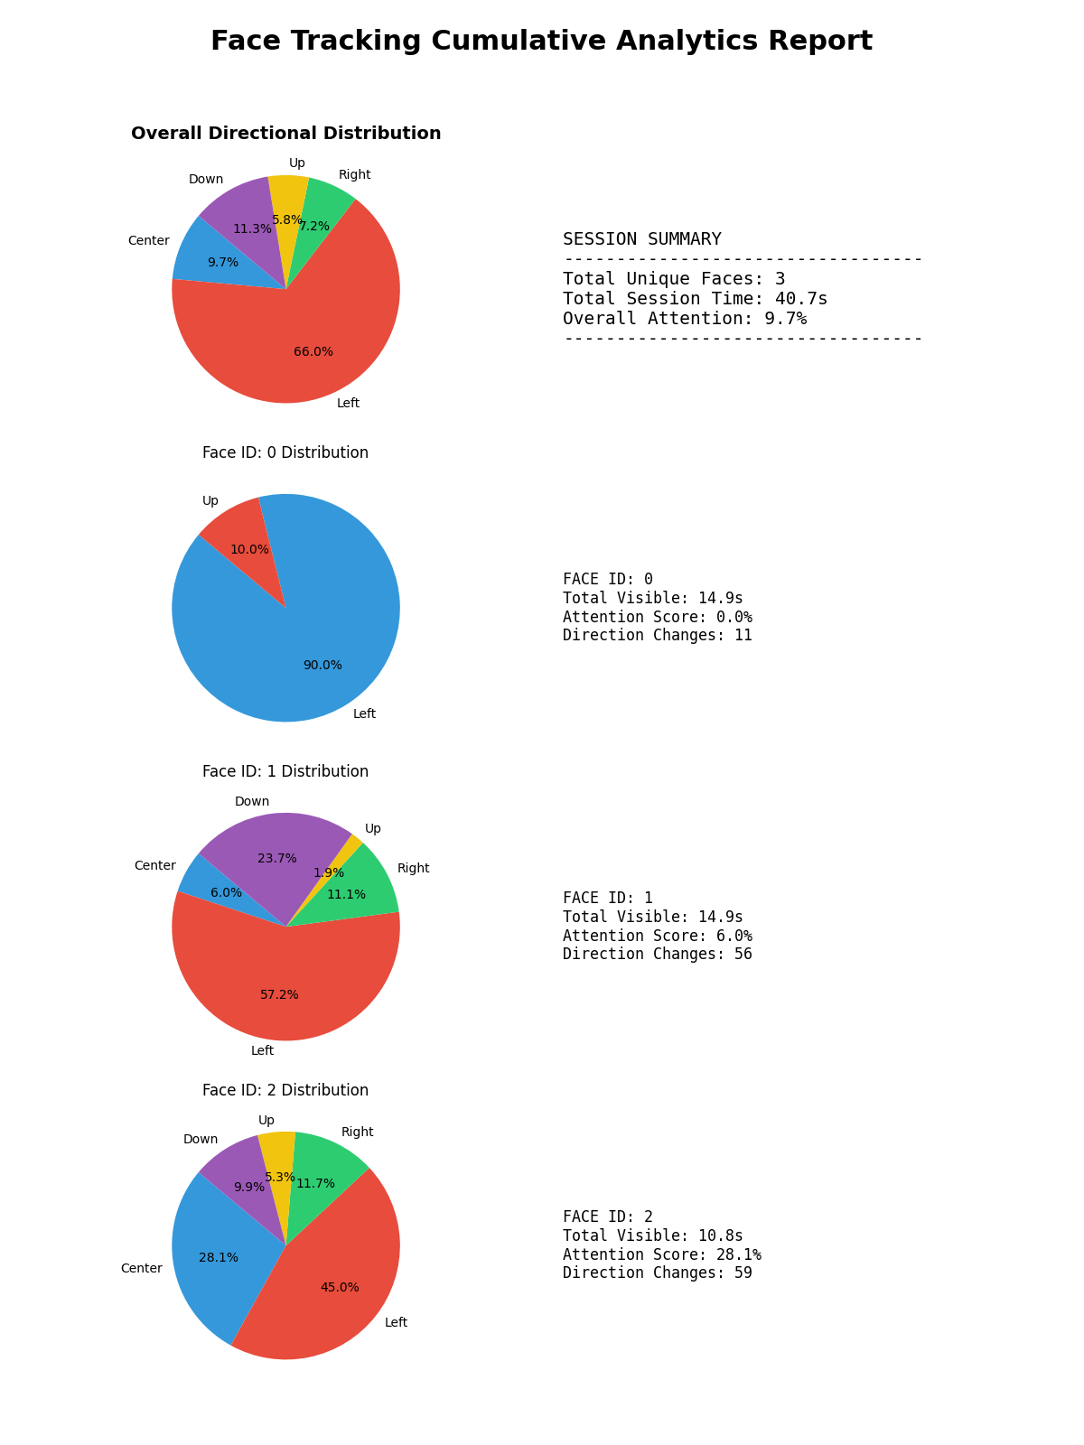
Results and Discussion
OUTPUT AND COMPARISON
Feature | Version 1 | Version 2
Detector | Haar cascades | MediaPipe
Faces | Largest only | Multiple
Identity | None | Persistent IDs
Accuracy | Moderate | Extremely high
Speed | Blazingly fast | Fast, more RAM
Report | None | Cumulative PNG
In the test run the report found 3 unique faces over 40.7 s. Version 2 trades extra RAM for better accuracy, stable IDs and this report; Version 1 stays useful where resources are limited.
Notes:
While running, the live window shows a green box, the direction, the face ID, the number of direction changes, the confidence and the FPS. On exit the report PNG is saved. Version 2 is more accurate and keeps identities, but needs more RAM than Version 1.

Slide 13
Limitations and Future Scope
HONEST LIMITS AND NEXT STEPS
LIMITATIONS
Direction is estimated from the nose position, not true 3D head pose.
Colour-histogram re-ID is affected by lighting changes.
Greedy matching can still err in crowded frames.
Kalman time step is fixed at 1/30 s.
Report shows at most 5 faces; Version 1 tracks one face.
FUTURE SCOPE
Use face-mesh landmarks to compute real yaw, pitch and roll.
Replace histograms with deep face embeddings for re-ID.
Use Hungarian matching and the measured frame time.
Export statistics as CSV and show a live dashboard.
Build a browser-based version using the web camera.
Notes:
The main limit is that direction is estimated from the nose inside the face box, which is an approximation of head pose. Real head pose angles would be the best next improvement.

Slide 14
Conclusion
SUMMARY
The tracker follows several faces at once and keeps each person's ID stable.
Kalman filtering and histogram re-identification cope with brief occlusion and returning faces.
The cumulative report turns tracking into attention statistics per person and for the whole session.
Version 1 remains a lightweight option for low-resource systems.
5
45
directions classified
frames of occlusion buffer
2 s
2
noise filter for reports
versions built
Notes:
To conclude: the system tracks several faces, keeps their IDs, handles short occlusions and produces an attention report. The four numbers on the right summarise the design.

Slide 15
References
SOURCES
[1] G. Bradski, "The OpenCV Library," Dr. Dobb's Journal of Software Tools, 2000.
[2] P. Viola and M. Jones, "Rapid object detection using a boosted cascade of simple features," Proc. IEEE CVPR, 2001.
[3] V. Bazarevsky et al., "BlazeFace: Sub-millisecond neural face detection on mobile GPUs," arXiv:1907.05047, 2019.
[4] R. E. Kalman, "A new approach to linear filtering and prediction problems," Journal of Basic Engineering, vol. 82, no. 1, 1960.
[5] C. R. Harris et al., "Array programming with NumPy," Nature, vol. 585, 2020.
[6] J. D. Hunter, "Matplotlib: A 2D graphics environment," Computing in Science & Engineering, vol. 9, no. 3, 2007.
Notes:
These are the sources for the techniques and libraries used in the project.

Slide 16
Thank You
UP
LEFT
RIGHT
Questions?
Chatanya Gupta · Roll No. 2024A1R189
Ankush Dev Singh · Roll No. 224A1R030
B.Tech CSE, Model Institute of Engineering and Technology, Jammu
DOWN
Notes:
Thank you. I am happy to answer questions, and I can run the live demo if needed.

